Slide 1
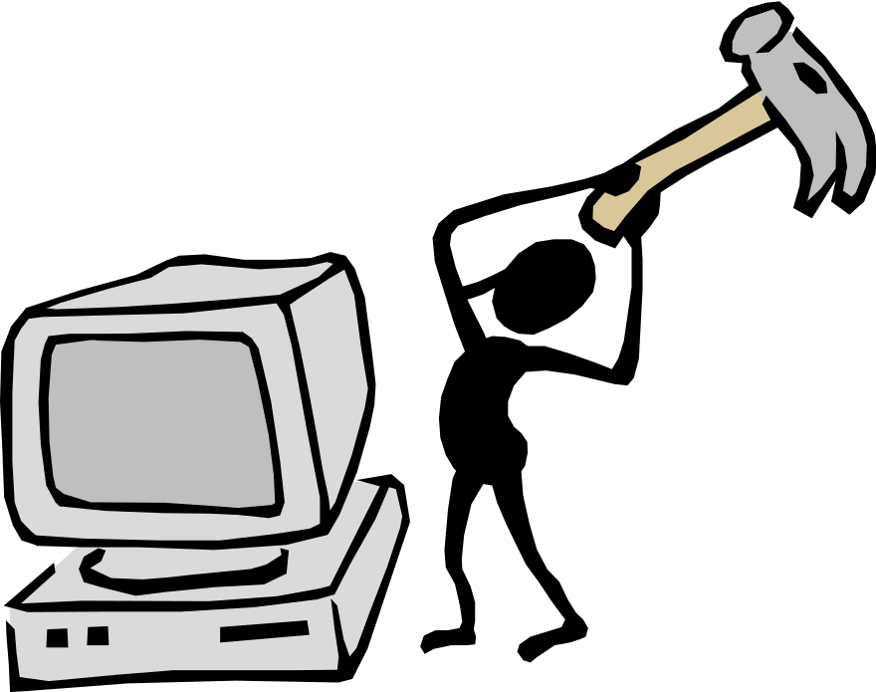
CSE 515 – Software Engineering & Design Pattern
A. H. M. Sajedul Hoque
Assistant Professor
Computer Science & Engineering
University of Chittagong

Slide 2
Instructor – A. H. M. Sajedul Hoque
Office : 302
Class Time : Thursday
10:30 am – 12:15 pm
Monday
11:30 am – 1:05 pm
Phone : +8801930-562552
E-Mail : sajidiuk@yahoo.com

Slide 3
Lecture 1, 2, 3 & 4
Introduction to Software Engineering

Slide 4
Outline
Overview of the Course
Introduction
Description of the software
Classes of Software products
What is Good Software?
Attributes of Software
Types of software
Software Engineering

Slide 5
Introduction
Data
Information
Data Processing System
Software
  A Set of instruction to acquire inputs and to manipulate them to produce the desired result
    In terms of functions and performance as determined by the user of the software
  Tell the computer what to do

Slide 6
Introduction
One-time programs
  It is typically developed by students
  Try it out
  See some useful results
  Throw it way
Software solution
  It is used for long duration
  It gives important service to people or organization

Slide 7
Goals of this course
To earn knowledge on the basics of Software Engineering
To earn knowledge on Object Oriented Analysis and Design Approach to develop software
To earn knowledge on Design Pattern

Slide 8
Course At a Glance
Credit Hours
  3
Number of Classes
  33
Total Marks
  75
Exam Duration
  4 Hours

Slide 9
Your Evaluation
Attendance : 7.5
Class Test : 15
Final Exam : 52.5

Slide 10
Contents of the Course
Basics of Software Engineering (SE)
Software Development Processes
Feasibility study
Project Management
Project Planning
Requirements Engineering
System Modeling
Architectural Design
Design & implementation
Design Patterns
Software Testing

Slide 11
Software System
Nature of Software Systems
  Software Systems are abstract and intangible
  They are not constrained by the properties of materials
  They are not governed by physical laws or by manufacturing processes

Slide 12
Software System
It is touching in all aspects of human life
  Business domain
  Engineering domain
  Scientific domain
Types of Software System
  Simple to Complex
  Internal use to Public use
  Single Function to Enterprise –wide
  One location to Distributed
  Batch or Real-time
  Informational to Machine-Critical

Slide 13
Description of Software
It is described by
  Its capabilities and
  Platform specifications
Capabilities relate to
  Functions: Sales-order Processing
  Features : Multi-currency computing, updating of sales, product & tax status
  Facilities : Printing of sales order, e-mail to customers, reports and advice to the stores department

Slide 14
Description of Software
Facilities and Features
  Optional
  Depends on customer
Platform relate to
  Hardware and
  Operating System Consideration

Slide 15
Professional Software Development
Professional Software
  Other People will use
  Other engineers will change
It includes
  Source code
  Executables
  Requirement Specification Document
  Design Document
  Operations and System Manuals
  Installation and Implementation Manuals

Slide 16
Professional Software Development
Professional Software development
  Software is intended for use by someone apart from its developer
  Software is developed by teams rather than individuals
  It is maintained and changed throughout its life by other engineers
  Software consists of
    A number of separate programs and configuration files that are used to set up these programs
    System documentation which describes the structure of the system
    User documentation which explains how to use the system
    Web sites for users to download the recent version
Amateur Software development
  Software is intended for use by developer
  We don’t have to worry about writing program guidelines documenting the program design

Slide 17
Professional Software Development
Software Engineering
  the systematic application of scientific and technological knowledge, methods, and experience to the design, implementation, testing, and documentation of software –wiki
  Software Engineering is a systematic approach to the production of software that takes into account practical cost, schedule and dependability issues as well as the needs of software customers and producers
  It is intended to support professional software development, rather than individual programming
  It includes techniques that support program
    Specification
    Design
    Development
    Testing
    Evolution

Slide 18
Successful Software System
When do we consider a software application successful
  Development Completed
  It is useful
  It is usable
  It is used
Software should be cost effective and maintainable

Slide 19
Good Software
Software is
  Required by customer
  Used by various end users in the organization
  Developed by Software engineer
Consideration of good software
  Customer : Cost Effectiveness
  Users : Usability & Reliability
  Software Engineer : Maintainability & Efficiency

Slide 20
Attributes of Good Software
Maintainability
  Software should be written in such a way that it may evolve to meet the changing needs of customers
Dependability
  It includes a range of characteristics: Reliability, Security and Safety
  Dependable software should not cause physical or economic damage in the event of system failure
  Malicious users should not be able to access or damage the system

Slide 21
Attributes of Good Software
Efficiency
  Software should not make wasteful use of system resources such as memory and processor cycles
  It includes responsiveness, processing time and memory utilization
Acceptability
  Software must be acceptable to the type of users for whom it is designed
  Software must be understandable, usable, and compatible with other systems that they use

Slide 22
Failure Software Project
Schedule Slippage
Cost Over-runs
Does not solve user’s problem
Poor quality of software
Poor Maintainability

Slide 23
Reasons for Failure Software Project
Ad hoc software development approach
  It seems straightforward
  Sit in front of machine the machine
  Talk to the clients
  Quickly understand the requirement
  Start coding

Slide 24
Problems of Ad Hoc Approach
No Planning of development work (no milestones defined)
Deliverables to user are not identified
Poor understanding of customer requirements, both by customer and developer
No control or review
Technical incompetence of developers
Poor understanding of cost and efforts by both developer and user

Slide 25
Any Alternative Approach?
Engineering Approach
Building
  Bridges, Dams
  Power Plants
  Aircrafts, Missiles
Well-Defined systematic Approach
  Repeatable
  Predictable

Slide 26
Engineering Approach
Requirement or need analysis
Conceptualization of product with specifications
Product Design
Process of manufacturing
Testing
Quality of assurance
Installation and implementation

Slide 27
Phases of Software Engineering
Requirements study and definition for determining software scope
Requirement Analysis to generate software specifications
Software design to deliver various components and specifications
Software development integration and testing
Implementation
Maintenance of software

Slide 28
Reasons of Software Engineering
Software produced is
  Unreliable
  Doubtful quality
  Delivered late to the customer
  Not maintainable under changing circumstances
  Inefficient in resource management
  Very expensive
Software becomes
  Costly and Risky
  User may not accept the solution
  It may not meet the performance
  It is not possible to update

Slide 29
Objectives of Software Engineering
To achieve customer satisfaction
To ensure on-time delivery
To be developed within the budget cost
To provide ease of maintenance to meet changing requirements

Slide 30
History of Software Engineering
The notion of “Software Engineering” was first proposed in 1968 at a conference held to discuss what was then called the “software crisis”
It became clear that individual approaches to program development did not scale up to large and complex software systems
These were unreliable, cost more than expected and were delivered late
Throughout the 1970s and 1980s, a variety of new software engineering techniques and methods were developed such as structured programming, information hiding and object oriented development

Slide 31
Classes of Software Products
Generic Products
  It is sold on the open market to any customer who is able to buy them
  It is managed by developer
  Requirements and specifications are controlled by developer
  Examples : Database Products, Browsers, ERP packages, Drawing Packages
Customized Product
  It is developed specially for that customer by a software contractor
  Requirements and specifications are controlled by customer
  Examples : Traffic Management system, Hospital Management system

Slide 32
Different types of applications
Stand-alone applications
  These are application systems that run on a local computer, such as a PC
  They include all necessary functionality and do not need to be connected to a network
  Example: Office applications on a PC, CAD programs, Photo manipulation software
Interactive transaction-based applications
  These are applications that execute on a remote computer and that are accessed by users from their own PCs or terminals
  It incorporate a large data store that is accessed and updated in each transaction
  Example:
    Web applications: e-commerce applications
    Business system : where a business provides access to its systems through a web browser or special purpose and cloud-based services such as mail and photo sharing

Slide 33
Different types of applications
Embedded control system
  These are software control systems that control and manage hardware devices
  It is written to perform certain functions under control conditions
  It is embedded into hardware
  It resides in ROM
  Examples: Washing Machine, Microwave oven, gas station etc.
Batch Processing System
  These are business systems that are designed to process data in large batches
  They process large numbers of individual inputs to create corresponding outputs
  These includes phone billing system and salary payment system

Slide 34
Types of Software
Entertainment Systems
  These are systems that are primarily for personal use and which are intended to entertain the user
  Most of these systems are games of one kind or another
  The quality of the user interaction offered is the most important distinguishing characteristics
Systems for Modeling and Simulation
  These are systems that are developed by scientists and engineers to model physical process or situations which include many, separate and interacting objects
  These are often computationally intensive and high-performance parallel systems for execution

Slide 35
Types of Software
Data Collection System
  These are systems that collect data from their environment using a set of sensors and send that data to other systems for processing
Systems of Systems
  These are systems that are composed of a number of other software system

Slide 36
Software Engineering Ethics
Moral responsibilities of Software Engineers
  Confidentiality
    Software Engineers should normally respect the confidentiality of employers or Clients irrespective of whether or not a formal confidentiality agreement has been signed
  Competence
    Software Engineers should not misrepresent his/her level of competence
    He/she should not knowingly accept work that is outside his/her competence
  Intellectual property rights
    He/she should be aware of local laws governing the use of intellectual property such as patents and copyright
  Computer Misuse
    He/she should not use his/her technical skills to misuse other people’s computers

Slide 37
CASE Tools
Computer-Aided Software Engineering
It covers a wide range of different types of program to software process activities
  Requirements Analysis
  System modeling
  Code Generation : source code from system model
  Process Guidance : What to do next
  Debugging and testing

Slide 38
Software Engineering Techniques
Two ways
  Structured System Analysis & Design (SSAD)
  Object Oriented Analysis & Design (OOAD)

Slide 39
SSAD approach
Yourdan and DeMarco
The system and its requirement are decomposed in structured manner
Software development is carried out using the subsystems
  Structure
  Tested
  Integrated
  implemented

Slide 40
Invoicing System
Invoicing System
Dispatch Verification
Delivery Note Processing
Order Status Verification
Process Sales Amount
Update of order for Dispatch Balance
Inventory Status Updation
Process Tax Component
Modify the Sales Analysis Status
Invoice Processing

Slide 41
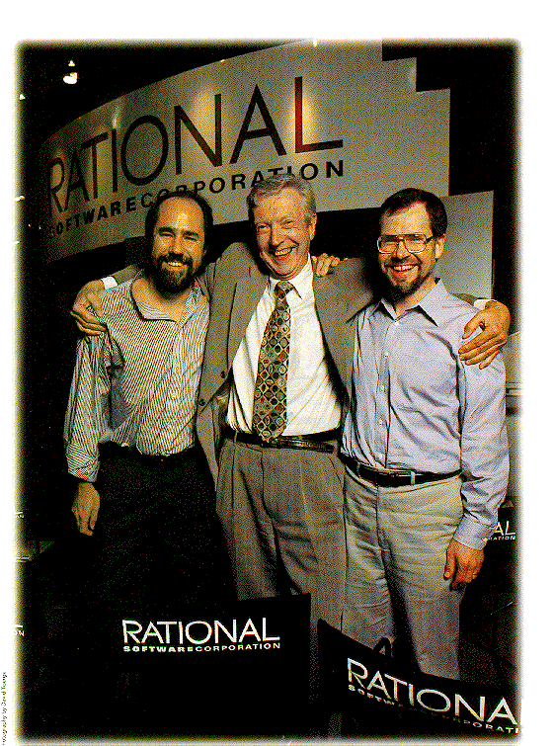
OOSD approach
Booch, Jackson and Rumbaugh
Software development is carried out using the subsystems
  Analysis of domain and organizations
  Builds objects of models

Slide 42
OOSAD approach
Object could represents
  A function, process and a document
Object has
  Attributes to describe
  Methods to perform
  Relationships to other objects

Slide 43
Advantages of OOAD
Development efficiency is higher
Costs of development are lower

Slide 44
Example OOAD
Invoice
Order
Id
No.
Address
A/C No.
Amount
Id
No.
Address
A/C No.
Amount
Compute value of goods
Compute discount
Compute Ad. Charge
Compute Invoice Amount
Compute value of goods
Compute discount
Compute Ad. Charge
Compute Net Order Value

Slide 45
SSAD versus OOSD
SSAD | OOAD
SSAD evolved from Structured Programming | OOAD evolved from Object Oriented Programming
It is process oriented | It is object oriented
It breakdowns the system using DFDs (Data Flow Diagram) | It breakdowns the system using use cases
The components of the system are derived from DFDs | The components of the system are derived from class diagrams and other UML diagrams
It has a separation of system data and processes | System’s data and processes are encapsulated into objects

Slide 46
END

